Slide 1
Multi Threading in Java
Basic to Advance level

Slide 2
Day 1

Slide 3
what is task ? what is multitasking?
A task is a specific piece of work or activity to be completed.
Multitasking is performing multiple tasks simultaneously.
what is process? what is multiprocessing?
A process is an instance of a program in execution.
Multiprocessing is the use of two or more processors to execute multiple processes simultaneously.

Slide 4
what is thread? what is multithreading? A thread is the smallest unit of a process that can be executed independently.
Multithreading is the concurrent execution of multiple threads within a single process. Why use threads?
Threads are used to improve the performance of applications by enabling parallel execution, allowing tasks to be handled concurrently, which can lead to faster processing and better resource utilization.

Slide 5
Thread States :
Threads can be in one of the following states:
New: The thread has been created but has not yet started.
Runnable: The thread is eligible to run, and it may be executing or waiting for its turn to execute.
Blocked: The thread is waiting for a monitor lock to enter a synchronized block/method.

Slide 6
Waiting: The thread is a waiting state, often waiting for another thread to perform a specific action.
Timed Waiting: Similar to the waiting state, but with a specified time duration for waiting.
Terminated: The thread has completed its task or has been terminated.

Slide 7
Creating and Running Threads
Extending the Thread class
Implementing the Runnable interface
Starting a thread
Naming threads
Thread priorities

Slide 8
Extending the Thread class:
Create a new class that extends the Thread class.
Override the run() method in your class. This method contains the code that will be executed when the thread starts.
Instantiate an object of your custom thread class.
Call the start() method on the thread object to begin its execution. The start() method internally calls the run() method.

Slide 9
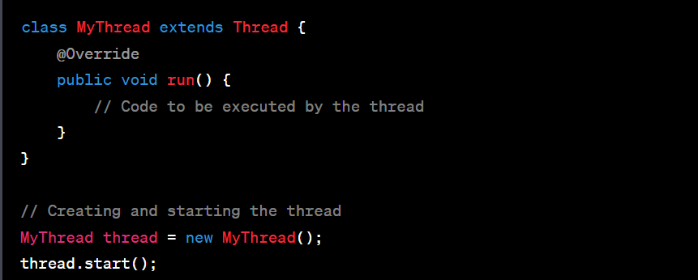

Slide 10
Implementing the Runnable interface:
Create a class that implements the Runnable interface.
Implement the run() method in your class, which contains the code to be executed by the thread.
Instantiate an object of your class.
Create a Thread object, passing the instance of your class as a parameter to its constructor.
Call the start() method on the Thread object to start the execution of the thread.

Slide 11
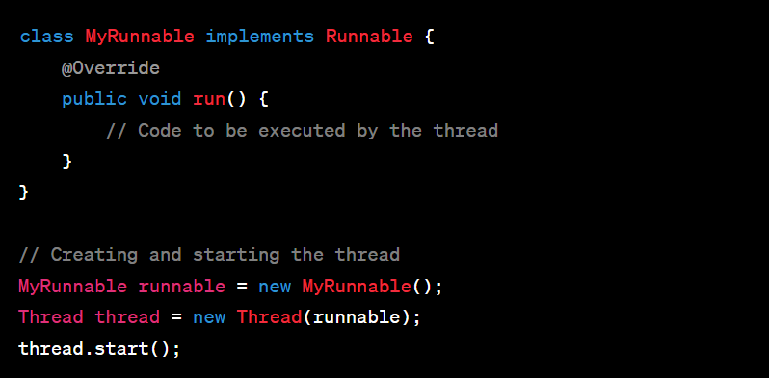

Slide 12
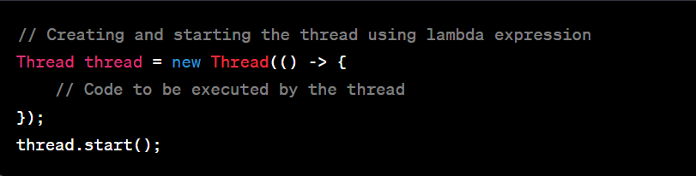
Lambda Expression (Java 8+):
Use lambda expressions to create an anonymous implementation of the Runnable interface.
Pass the lambda expression to the Thread constructor.
Call the start() method on the Thread object to start the thread.

Slide 13
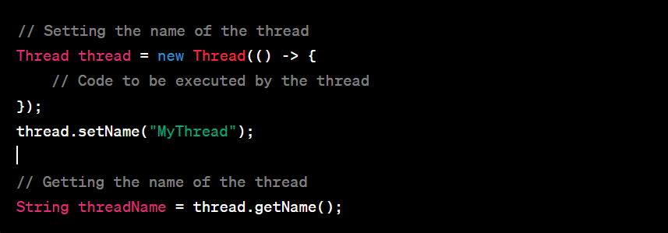
Thread Name:
We can assign a name to a thread by calling the setName() method or by passing the name as a parameter to the Thread constructor.
The name can be retrieved using the getName() method.

Slide 14
Remember, when a thread's run() method is invoked, it runs independently alongside other threads. The order of execution and context switching between threads is managed by the underlying operating system and the JVM.
Creating and running threads is the foundation of multi-threaded programming. Once you understand this concept, you can explore synchronization, communication between threads, and more advanced topics to build robust and concurrent applications.

Slide 15
Thread priorities
Thread Priority Levels:
Thread priorities in Java are represented by integer values.
The range of thread priorities is typically from 1 (lowest) to 10 (highest).
The Thread class provides constants for priority levels: MIN_PRIORITY (1), NORM_PRIORITY (5), and MAX_PRIORITY (10).
Setting Thread Priority:
You can set the priority of a thread using the setPriority() method, which accepts an integer value representing the desired priority level.
The default priority of a thread is NORM_PRIORITY (5).

Slide 16
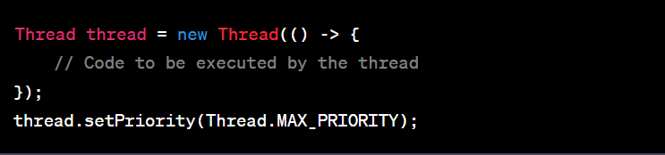

Slide 17
Day 2

Slide 18
Introduction to thread synchronization :
Thread synchronization is a mechanism that ensures that two or more threads can safely access shared resources without conflict. If one performance is happening another performance is wait until to finish the first performance.
This is called Synchronization.

Slide 19
What is Synchronization in java and why we need it ?
Class SbiBank
Saddam Account (Object)
Debit card
(withdraw)
UPI
(Deposit)

Slide 20
Saddam account have total balance = 7000
Saddam withdraw = 3000
--------------------
After withdraw remaining balance = 4000
Saddam withdraw 3000 balance at same time Someone deposit 12000 in Saddam account.
Now Saddam account Total Balance is 12000 + 4000 = 16000.
Important Note :
Both the transactions are happening at same time at milli second or nano second difference.

Slide 21
Without Synchronization
Saddam account total balance = 7000
Saddam withdraw = 3000
After withdraw remaining balance = 4000
Someone deposit 10000 to Saddam account at same time
Actual Saddam Total Amount = 14000
Saddam will enquire the balance
If it will show 4000 Saddam loss 10000
If it will show 10000 Saddam loss 4000

Slide 22
Java Programming
Class SbiBank
Saddam Account (Object)
ATM
Thread 1
Google pay Thread 2
Debit card
(withdraw)
UPI
(Deposit)
Withdraw() - m1
Deposit() - m2

Slide 23
Saddam Account object
Thread 1 synchronized m1 (Object lock)
Thread 2 synchronized m2 (waiting)

Slide 24
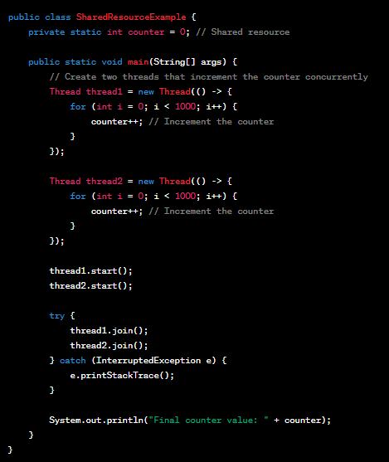
Shared resources and data races
Shared resources are variables or objects that multiple threads use together, and data races happen when threads try to change the same resource at the same time, causing errors.

Slide 25
To fix this data race, synchronization mechanisms is introduced, such as using the synchronized keyword or locks, to ensure that only one thread can access and modify the shared resource at a time.
This prevents data races and ensures consistent and predictable results.

Slide 26
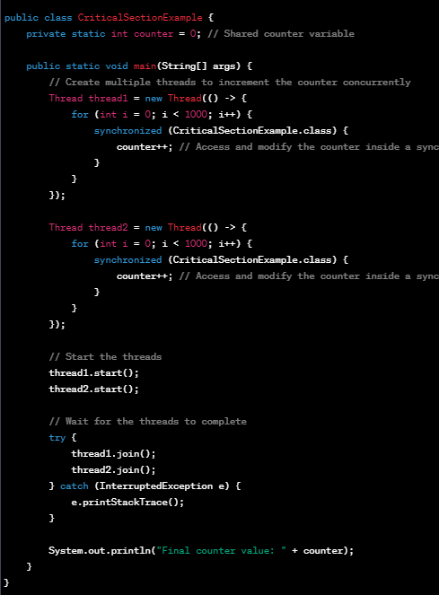
Critical sections and mutual exclusion
Critical Sections: Specific parts of the code where shared resources are accessed and modified.
Mutual Exclusion: Ensures only one thread can access a critical section at a time, preventing conflicts and maintaining data integrity.

Slide 27
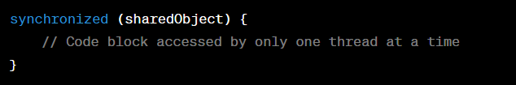
Synchronized blocks and methods
Synchronized Blocks: Allows a specific section of code to be accessed by only one thread at a time, ensuring mutual exclusion. For example:

Slide 28
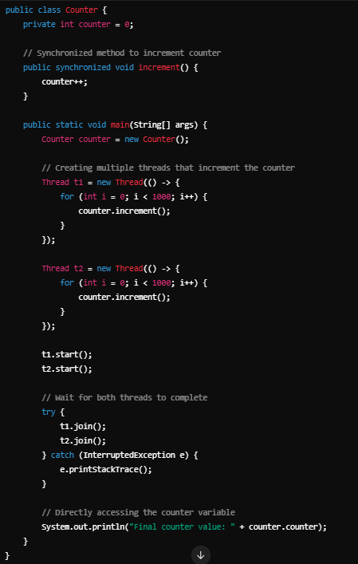
Synchronized Methods:
Ensures that only one thread can execute the entire method at a time, providing mutual exclusion.
In both examples, the synchronized keyword ensures that only one thread can access the synchronized block or method at any given time, preventing conflicts and maintaining data integrity.

Slide 29
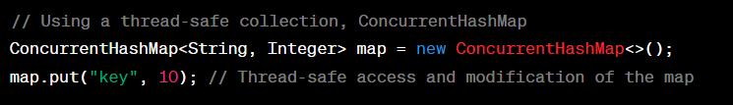
Thread-safe collections and classes
Thread-safe collections and classes that are designed to be used by multiple threads concurrently without requiring additional synchronization.
They provide built-in mechanisms to ensure safe access and modification of data in a multi-threaded environment. For example:

Slide 30
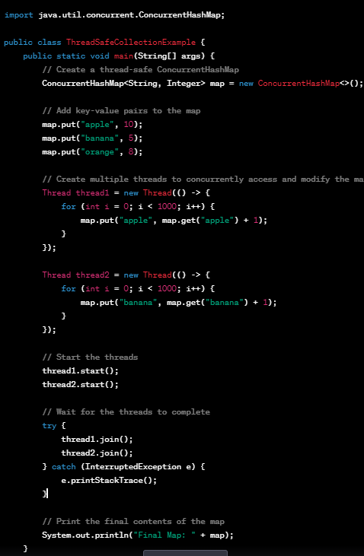

Slide 31
Day 3

Slide 32
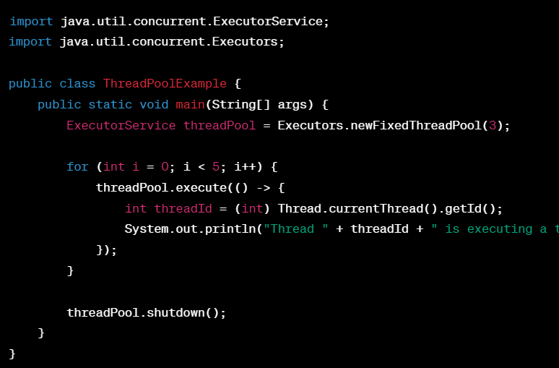
Introduction to thread pools
Thread pools are a group of pre-initialized worker threads that can be used to efficiently execute multiple tasks concurrently.
They help in managing and reusing threads, reducing the overhead of creating new threads for each task.

Slide 33
The Executor framework
The Executor framework in Java simplifies concurrent task execution by managing threads and provides a way to execute tasks asynchronously using thread pools.

Slide 34
Executors:
The Executors class in Java provides factory methods to create instances of ExecutorService, which is used to manage and execute tasks.
ExecutorService:
ExecutorService is a higher-level interface that extends Executor and provides additional methods to manage asynchronous task execution and handle the result of tasks.
ThreadPoolExecutor:
ThreadPoolExecutor is an implementation of the ExecutorService interface that provides a thread pool to execute tasks concurrently, reusing threads to minimize the overhead of thread creation.

Slide 35
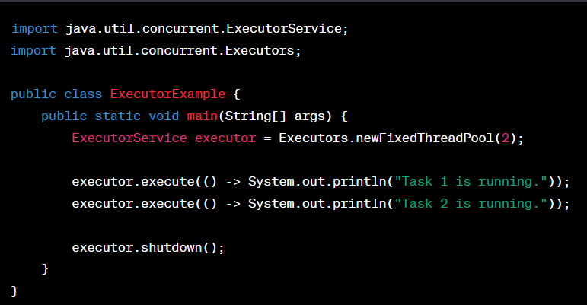

Slide 36
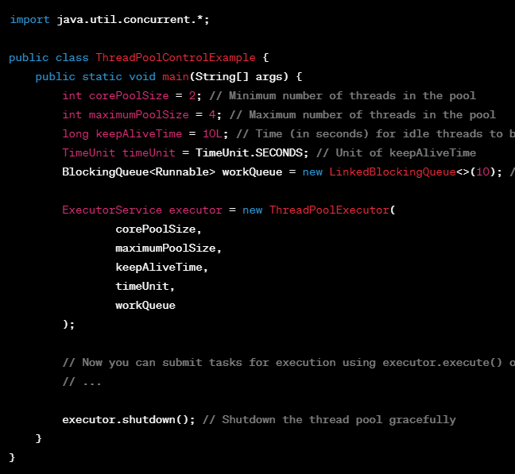
Controlling Thread Pool Size and Behavior:
we can control the thread pool size and behavior by creating a ThreadPoolExecutor instance directly, providing the desired parameters for core pool size, maximum pool size, and task queuing.

Slide 37
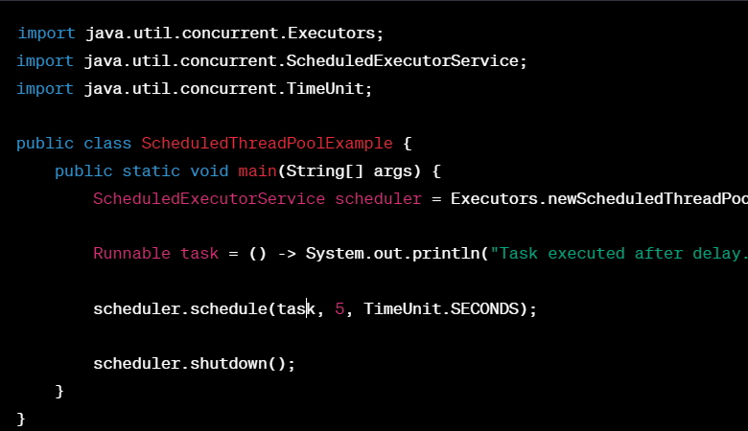
Scheduled Thread Pools:
Scheduled thread pools in Java are used to execute tasks at specific intervals or after a delay. They are suitable for scheduling recurring tasks.

Slide 38
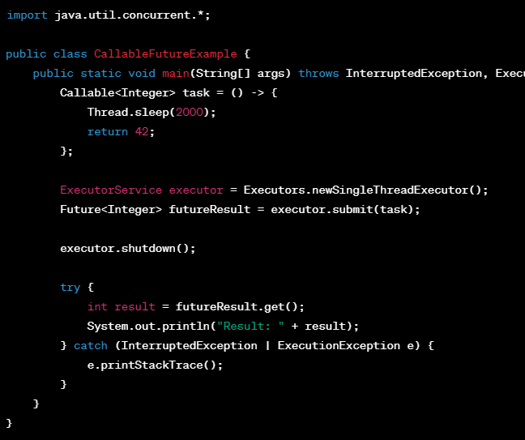
Callable and Future for Retrieving Results:
In Java, Callable is an interface that represents a task that can return a result. Future is an interface used to hold the result of a Callable task until it's ready.

Slide 39
Day 4

Slide 40
Sequential Stream:
In the sequential stream, the operations are performed sequentially on a single thread.
Each number is squared one after the other.
Parallel Stream:
In the parallel stream, Java automatically distributes the work across multiple threads.
This can lead to faster processing, especially when dealing with large datasets.

Slide 41
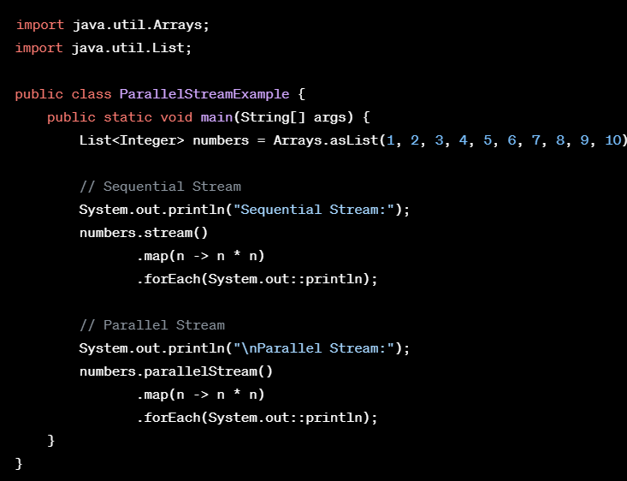

Slide 42
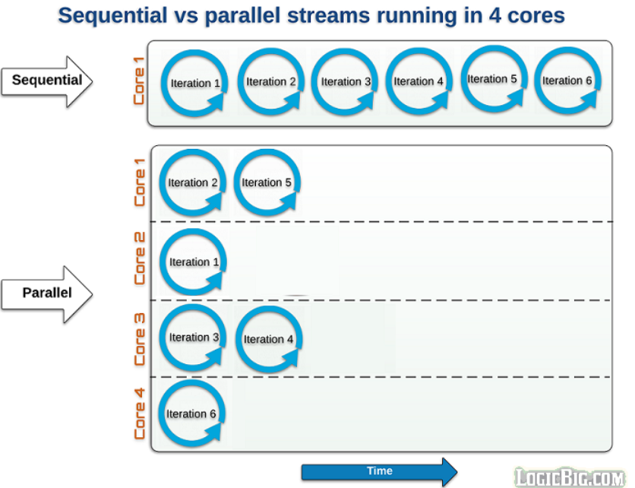

Slide 43
CompletableFuture for asynchronous programming
Agenda
What is CompletableFuture?
Why CompletableFuture ?
How to create CompletableFuture
How to use runAsync and supplyAsyn method with usecase

Slide 44
What is CompletableFuture ?
CompletableFuture is used for Asynchronous programming we can write non-blocking code where concurrently we can run N no of tasks in separate thread without blocking main thread.
When the task is complete, it notifies to the main thread (whether the task was completed or failed).

Slide 45
Why CompletableFuture ?
There are different ways to implement asynchronous programming in Java using any of the below mechanisms for example you can use Futures, ExecutorService, Callback interfaces,Thread Pools, etc.
It cannot be manually completed
Multiple Futures cannot be chained together
We cannot combine multiple Futures together
No Proper Exception Handling Mechanism

Slide 46
How to use runAsync and supplyAsyn method with usecase
runAsync()
If we want to run some background task asynchronously and do not want to return anything from that task, then use CompletableFuture.runAsync() method.
It takes a Runnable object and returns CompletableFuture<Void>.
CompletableFuture.runAsync(Runnable) -> ForkJoinPool.commonpool
CompletableFuture.runAsync(Runnable, Executor) -> executor Pool-thread

Slide 47
supplyAsyn()
If we want to run some background task asynchronously and want to return anything from that task, we should use CompletableFuture.supplyAsync().
It takes a Supplier<T> and returns CompletableFuture<T> where T is the type of the value obtained by calling the given supplier.
CompletableFuture. supplyAsync(Supplier<T>) -> ForkJoinPool.commonpool
CompletableFuture. supplyAsync(Supplier<T>,Executor) -> executor Pool-thread

Slide 48
Transforming and acting on a CompletableFuture
thenApply()
We can use thenApply() method to process and transform the result of a CompletableFuture when it arrives.
It takes a Function<T,R> as an argument. Function<T,R> is a simple functional interface representing a function that accepts an argument of type T and produces a result of type R.

Slide 49
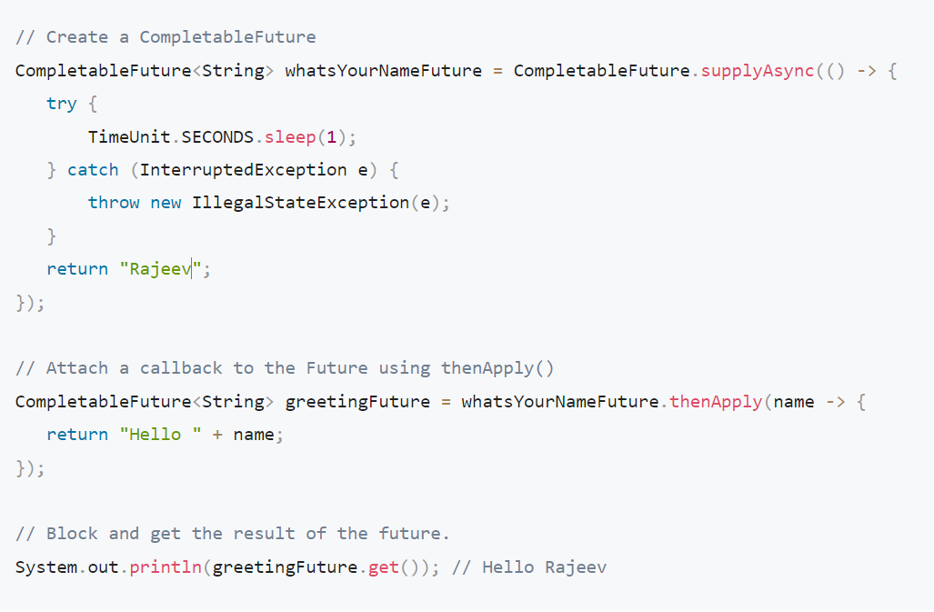

Slide 50
we can also write a sequence of transformations on the CompletableFuture by attaching a series of thenApply() callback methods.
The result of one thenApply() method is passed to the next in the series

Slide 51
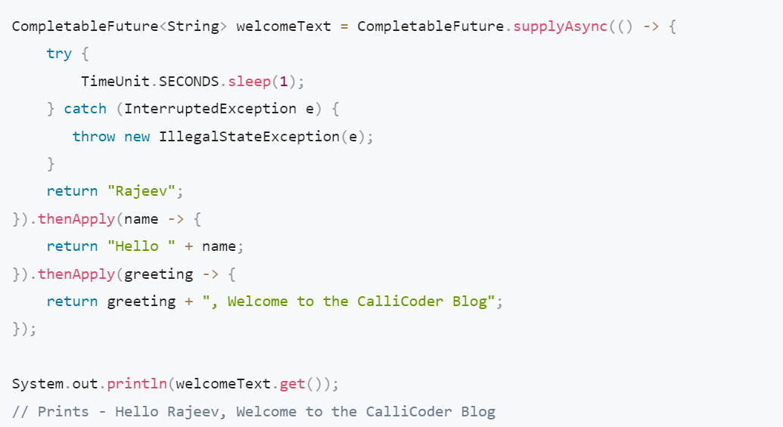

Slide 52
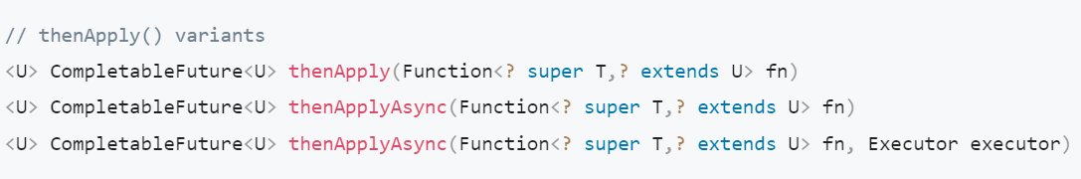
A note about async callback methods :
All the callback methods provided by CompletableFuture have two async variants -

Slide 53
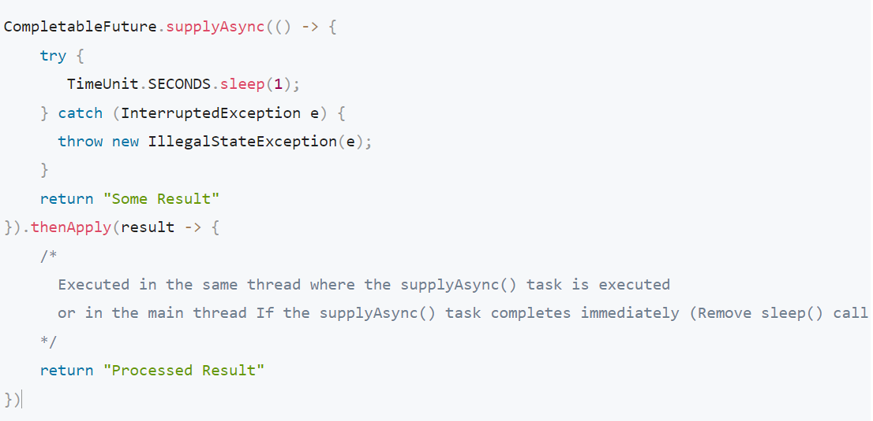

Slide 54
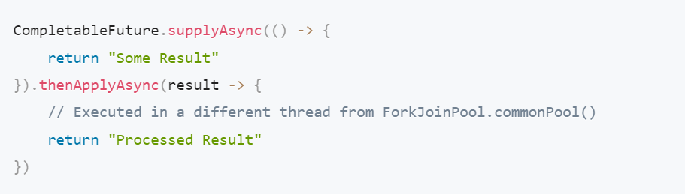

Slide 55
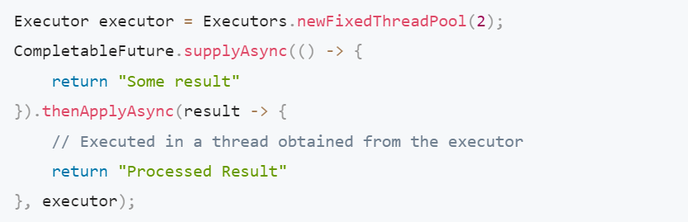

Slide 56
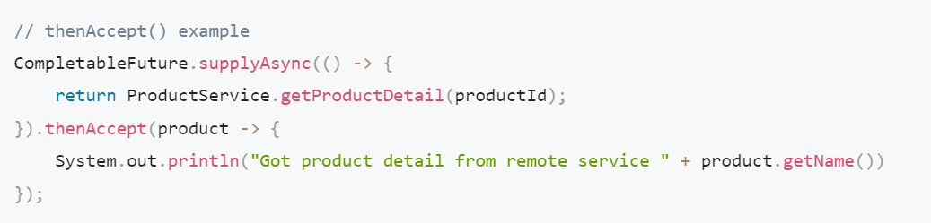
thenAccept() and thenRun()
If we don’t want to return anything from your callback function and just want to run some piece of code after the completion of the Future, then you can use thenAccept() and thenRun() methods.

Slide 57
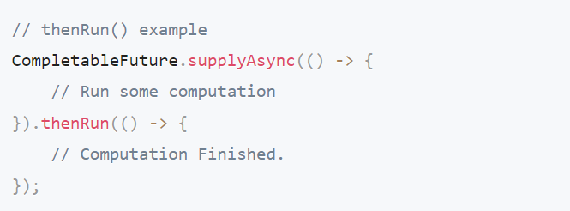

Slide 58
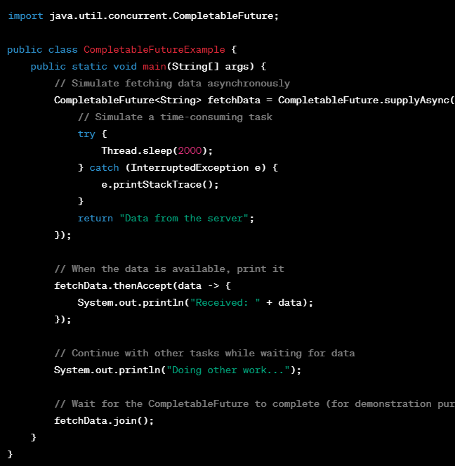
join(): The join() method makes a thread pause its work until another thread is done with its task.
It also throws a CompletionException (unchecked exception) if completed exceptionally.

Slide 59
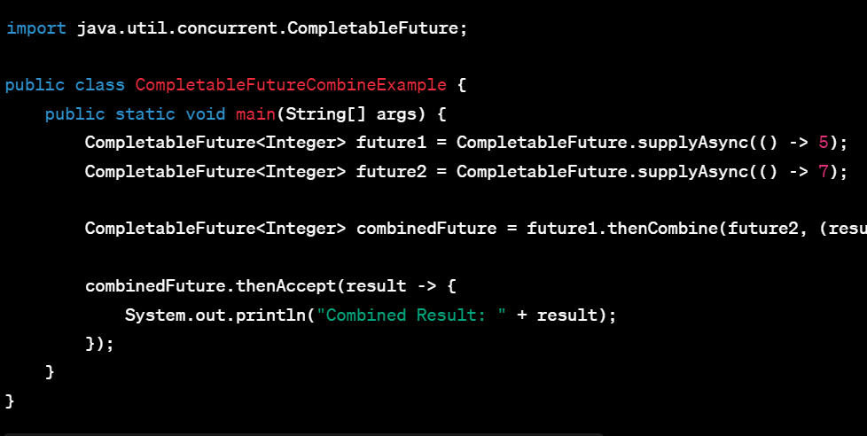
thenCombine () : It combine results from multiple asynchronous tasks.

Slide 60
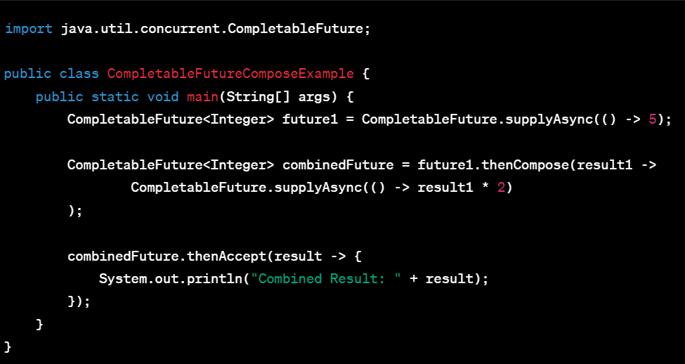
thenCompose() :
Flattens the result of one future into another. It waits for the first future to complete and then starts a second future based on that result.

Slide 61
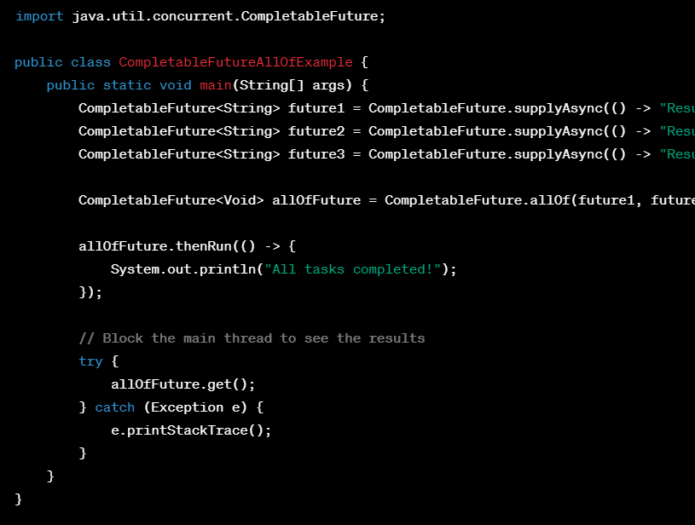
allOf() :
The CompletableFuture.allOf() method in Java is used to create a new CompletableFuture
It waits for all tasks to finish before doing anything else.

Slide 62
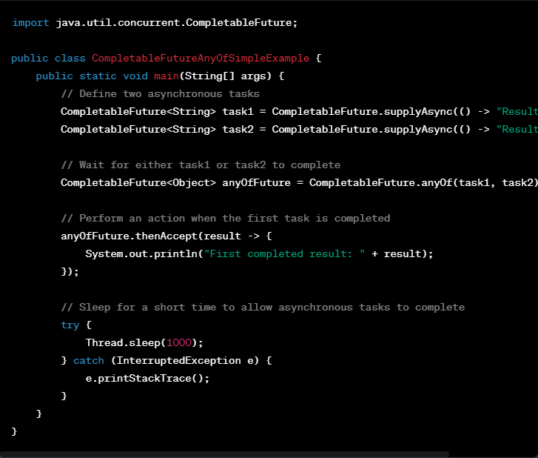
anyOf() :
returns a new CompletableFuture which is completed when any of the given CompletableFutures complete, with the same result.

Slide 63
Handling exceptions in CompletableFutures
Handling exceptions in CompletableFutures can be done using methods like exceptionally or handle
exceptionally()
We can handle exceptions in CompletableFutures by providing a fallback value when an exception occurs during task execution.
Handle()
The handle method in CompletableFutures allows you to handle both the result and exceptions, offering flexibility in recovery or processing."

Slide 64
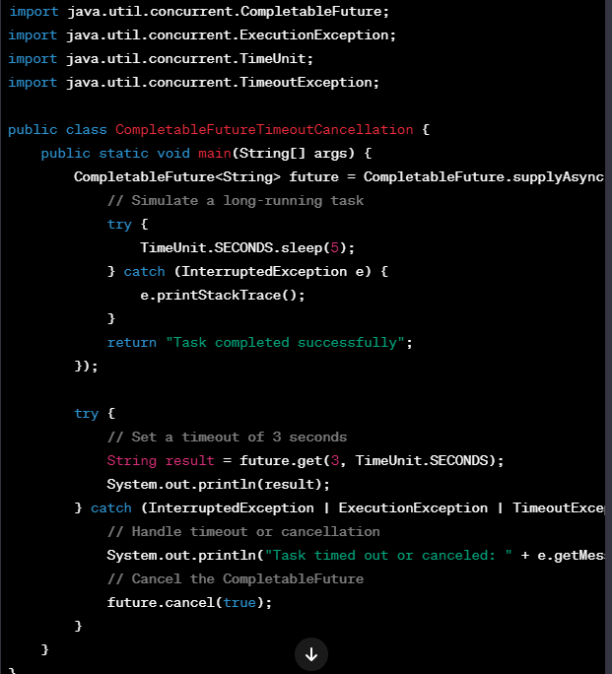
CompletableFuture timeouts and cancellation :
We can set timeouts to limit the maximum duration of a task, and if the task exceeds the specified time, it can be cancelled."

Slide 65
Day 5

Slide 66
Thread communication methods (wait, notify, notifyAll)
Two threads can communicate with each other by using wait(), notify() and notifyAll() methods.
wait() - Pauses the thread until another thread calls notify() or notifyAll().
notify() - Wakes up a single waiting thread.
notifyAll() - Wakes up all waiting threads.
Wait()
Thread 1
Thread 2
Notify(), NotifyAll()

Slide 67
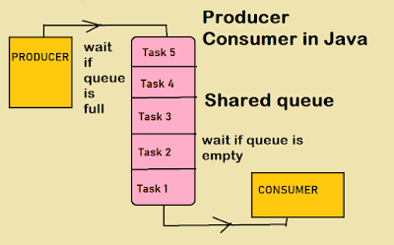
The Producer-Consumer problem
Producer: A thread responsible for producing or generating data/items and adding them to a shared buffer.
Consumer: A thread responsible for consuming or processing data/items from the shared buffer.

Slide 68
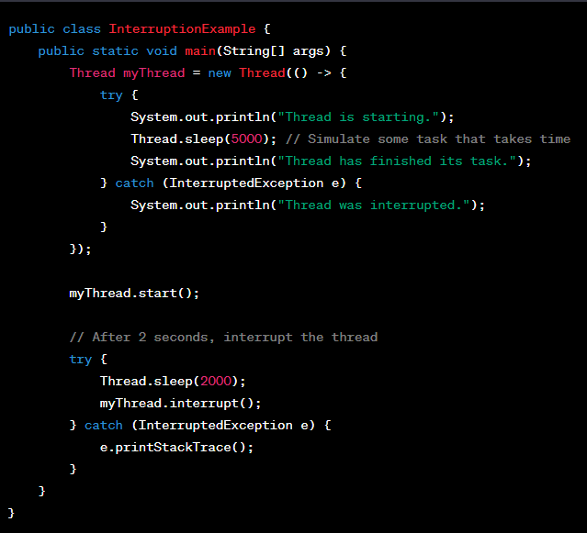
Thread interruption and interruption handling
Thread interruption is a way to signal a thread to stop its execution gracefully.
Interruption handling is the process of checking for interruptions and taking appropriate actions, such as cleaning up resources and terminating the thread, in response to the interruption signal.

Slide 69
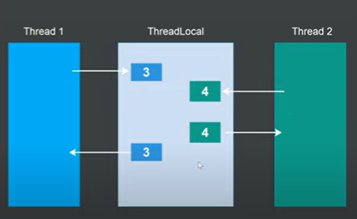
Thread local variables :
Thread-local variables are like personal storage boxes for each thread, allowing them to keep their data separate from others.

Slide 70
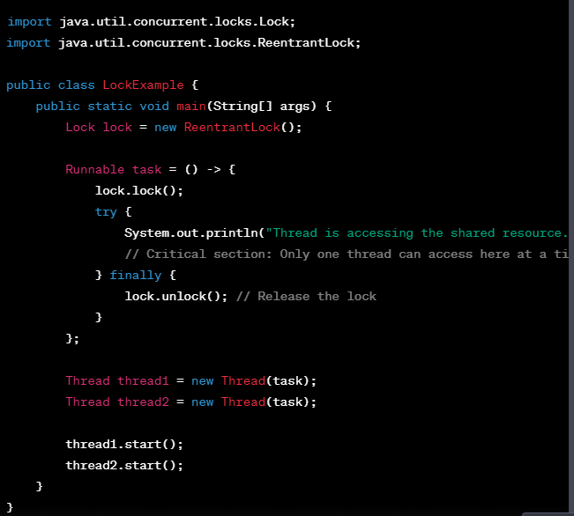
Locks and Mutexes:
Locks and mutexes are synchronization mechanisms that allow only one thread to access a shared resource at a time, ensuring data consistency in multithreaded applications.

Slide 71
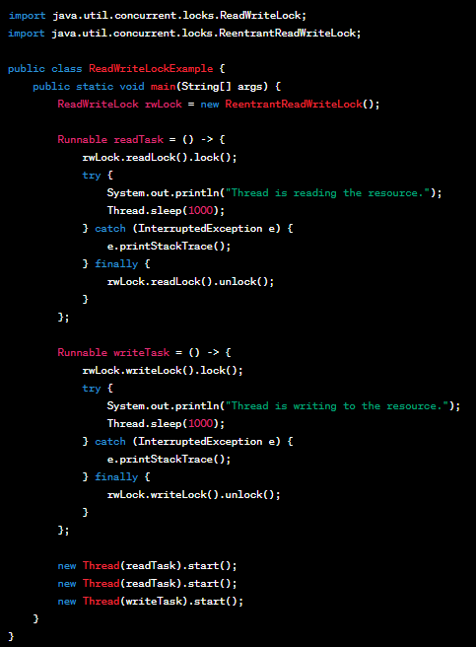
ReadWriteLock is an interface in Java that provides a way to manage concurrent access to a shared resource where reads can be performed simultaneously by multiple threads, but writes require exclusive access.

Slide 72
Thank you all……

